Slide 1
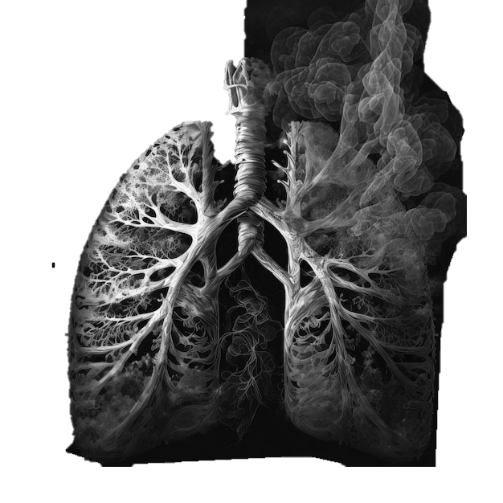
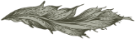
Next-Gen Lung Disease Detection
Ganesh M RA2211026010146
Mohit G RA2211026010142
Ganesh T RA2211026010147
Abhiram M RA2211026010152

Slide 2
Abstract
This project aims to develop a predictive modeling system for lung health using advanced machine learning and deep learning techniques. By leveraging large datasets of medical images and patient records, the system will identify patterns and risk factors associated with lung diseases. The proposed model will utilize convolutional neural networks (CNNs) and other deep learning architectures to analyze chest X-rays, CT scans, and other relevant data. The expected outcomes include improved diagnostic accuracy, early detection of lung diseases, and personalized treatment recommendations. This project has the potential to revolutionize lung disease management and enhance patient care through innovative AI-driven solutions.

Slide 3
Literature Survey
Journal Name and Date | Paper Title and Authors | Problem Statement and Dataset used | Methodology Used | Inferences
IEEE Access October 2023 | Prediction of Lung Cancer using Deep Learning Model Authors: Rabia Javed et al | The study aims to improve the accuracy of lung cancer detection using deep learning models. Dataset: CT images | Deep Convolutional Neural Networks (DCNN) | DCNNs significantly enhance the accuracy of lung cancer detection.
IEEE Transactions on Medical Imaging July 2023 | Multi-Classification of Respiratory Diseases using Deep Learning Authors: Alyaa Hamel Sfayyih et al | The paper focuses on classifying multiple respiratory diseases using deep learning. Dataset: Chest X-rays | Convolutional Neural Networks (CNN) | CNNs show high accuracy in classifying various respiratory diseases.

Slide 4
IEEE Access April 2021 | Recognition of Pulmonary Diseases from Lung Sounds using Convolutional Neural Networks Authors: Mohammed A. A. Al-qaness et al | The study investigates the use of CNNs for recognizing multiple pulmonary diseases from lung sound signals. Dataset: Lung sound signals | CNNs, Long Short-Term Memory (LSTM) units | CNNs and LSTMs effectively classify lung diseases from sound signals
IEEE Transactions on Biomedical Engineering February 2024 | Explainable Lung Disease Classification from Chest X-Ray Images Authors: Stefanus Tao Hwa Kieu et al | The paper develops deep learning and transformer-based models for diagnosing lung disorders. Dataset: Chest X-ray images | Deep Learning (DL), Transformer models | DL and transformer models provide high accuracy in lung disease classification
IEEE Access February 2024 | Detection of Lung Disorders from X-Ray Images Using Hybrid Deep Learning Authors: Mohammed A. A. Al-qaness et al | The research aims to develop an intelligent system for diagnosing lung diseases from chest X-rays. Dataset: Chest X-ray images | Hybrid Deep Learning models | Hybrid models improve diagnostic accuracy and reliability

Slide 5
ACM Transactions on Multimedia Computing, Communications, and Applications February 2024 | Explainable Lung Disease Classification from Chest X-Ray Images Authors: Stefanus Tao Hwa Kieu et al | The paper develops deep learning and transformer-based models for diagnosing lung disorders. Dataset: Chest X-ray images | Deep Learning (DL), Transformer models | DL and transformer models provide high accuracy in lung disease classification.
ACM Transactions on Intelligent Systems and Technology December 2020 | Recognition of Pulmonary Diseases from Lung Sounds using Convolutional Neural Networks Authors: Mohammed A. A et al | The study investigates the use of CNNs for recognizing multiple pulmonary diseases from lung sound signals. Dataset: Lung sound signals | CNNs, Long Short-Term Memory (LSTM) units | CNNs and LSTMs effectively classify lung diseases from sound signals
SpringerLink April 2024 | Deep Learning for Lung Cancer Detection: A Review Authors: Rabia Javed, et al | The study aims to automate the diagnosis and classification of lung cancer using deep learning techniques. Dataset: X-rays, WSI, CT scans, MRI | Deep Convolutional Neural Networks (DCNN) | DCNNs significantly improve the accuracy of lung cancer detection and classification

Slide 6
Nature Communications 2022 | A Novel Deep Learning Framework for Lung Cancer Detection and Classification Authors: Zhang, Y., et al. | To develop a highly accurate and efficient deep learning framework for lung cancer detection and classification, using CT images. Dataset:LUNA16 dataset, TCGA Lung Cancer dataset | A hybrid deep learning architecture combining convolutional neural networks and recurrent neural networks | The proposed framework achieved high accuracy and sensitivity in lung cancer detection and classification, but further validation is needed on larger and more diverse datasets.
Journal of Medical Imaging and Health Informatics 2021 | Lung Cancer Detection Using Deep Learning: A Comparative Study Authors: Chen, Y., et al. | To compare the performance of different deep learning architectures for lung cancer detection, using CT images. Dataset: LIDC-IDRI dataset, TCGA Lung Cancer dataset | Various deep learning architectures, including VGG, ResNet, and DenseNet | ResNet consistently outperformed other architectures in lung cancer detection, but further research is needed to explore the reasons for its superiority.
EEE Transactions on Medical Imaging 2023 | Deep Learning for Lung Cancer Detection: A Review Authors:Huang, X., et al. | To provide a comprehensive overview of recent advances in deep learning for lung cancer detection, including convolutional neural networks, recurrent neural networks, and generative adversarial networks. Dataset:LIDC-IDRI dataset, TCGA Lung Cancer dataset | Various deep learning architectures and techniques | While deep learning has shown promising results in lung cancer detection, there are still challenges such as small sample sizes, class imbalance, and computational costs.
6

Slide 7
Findings In The Existing System
Current Methods | Strengths | Weaknesses | Challenges
Manual diagnosis by radiologists. Spirometry for lung function assessment. Biomarker analysis from blood or sputum samples. | Established diagnostic protocols. Experienced healthcare professionals. Technological advancements in imaging. | Subjectivity in manual diagnosis.(3,4,5) Limited early detection capabilities.(3,6,7) Resource-intensive processes.(1,2,5,8) Complexity in model interpretation and explainability(4,6,1) | Variability in data quality. Integration of AI models into healthcare systems. Ensuring model interpretability for clinicians.

Slide 8
Problem Statement
Lung diseases, including chronic obstructive pulmonary disease (COPD) and lung cancer, are major global health issues with high morbidity and mortality rates. Accurate, early diagnosis is essential for effective treatment and improved patient outcomes. Traditional diagnostic methods, such as manual examination of medical images, are time-consuming and subject to variability. This project addresses these challenges by developing a machine learning-based diagnostic tool that automates lung disease detection with high accuracy, reducing the dependency on manual diagnostic processes and facilitating quicker diagnosis.

Slide 9
Objective
To develop a predictive model using CNNs and EfficientNetB3 that accurately identifies lung disease from medical images.
To integrate deep learning algorithms that can classify lung conditions and assess disease severity.
To evaluate the model’s performance through metrics such as accuracy, sensitivity, and specificity to ensure reliable clinical application.
To create an interpretable model that clinicians can use to support and enhance the traditional diagnostic process.

Slide 10
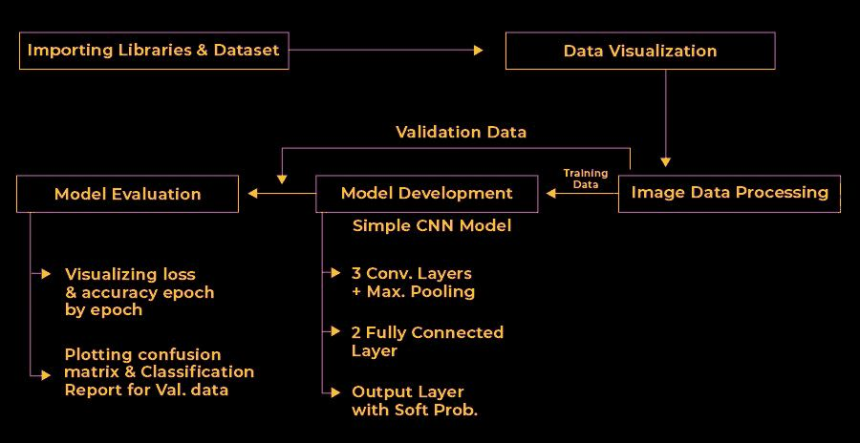
Block Diagram

Slide 11
Data Set Source
Source: Kaggle
Dataset Name: Lung and Colon Cancer Histopathological Images
Link: Kaggle Dataset
Description:
Purpose: This dataset contains histopathological images of lung tissues, used for detecting cancerous patterns and training deep learning models.
Content:
The dataset consists of 15,000 images of lung tissue divided into three categories:
Lung adenocarcinoma (LUAD): 5,000 images.
Lung benign tissue (BND): 5,000 images.
Lung squamous cell carcinoma (LUSC): 5,000 images.
Image Specifications:
Images are provided in .tif format.
Each image has a resolution of 768x768 pixels.
Classes:
Binary classification with two cancerous types (LUAD, LUSC) and one benign tissue class (BND).
Preprocessing:
Resizing: Images are resized (e.g., 224x224 or 128x128) to fit the input size of the CNN model.
Normalization: Pixel values are normalized between 0 and 1.
Data Augmentation: Techniques like rotation, flipping, and zooming are applied to increase dataset variability and improve generalization.

Slide 12
Mathematical Modelling of the Algorithm
A typical CNN consists of a series of layers: convolution, activation, pooling, and fully connected layers. Here's how each component can be mathematically modeled.
Input Image Representation
Each lung image X is represented as a matrix of pixel values. If the image is colored (RGB), it is a 3D matrix:
X = {R}^{H * W * C}
Where:
H is the height (e.g., 224 pixels),
W is the width (e.g., 224 pixels),
C is the number of channels (3 for RGB images).

Slide 13
Mathematical Modelling of the Algorithm
Convolutional Layer
The convolution operation applies a filter WWW (also called a kernel) to the input image or feature map to extract features. The formula for the 2D convolution is:
Z(i,j)=m=0∑M−1​n=0∑N−1​X(i+m , j+n)⋅W(m,n)+b
Where:
X is the input image or feature map,
W is the filter (kernel),
b is the bias term,
M×N is the size of the filter (e.g., 3x3 or 5x5),
Z(i, j) is the resulting feature map after applying the filter.
Multiple filters are applied to the input image, resulting in multiple feature maps.

Slide 14
Mathematical Modelling of the Algorithm
Activation Function (ReLU)
After applying the convolution, the ReLU (Rectified Linear Unit) activation function is used to introduce non-linearity into the model. ReLU is defined as:
ReLU(x)=max⁡(0,x)
Where:
X is the output from the convolution layer.
If x is negative, ReLU outputs 0; otherwise, it outputs x.
Pooling Layer (Max Pooling)
Max pooling reduces the spatial dimensions of the feature map while retaining the most important information. The operation selects the maximum value in a window (typically 2×2):
P(i,j)=max⁡m,nZ(i+m,j+n)
Where:
P(i,j)P(i, j)P(i,j) is the output of the pooling layer,
Z(i+m,j+n)Z(i+m, j+n)Z(i+m,j+n) is the local region (e.g., 2×2) from the feature map.
This operation reduces the size of the feature map, allowing the model to focus on the most important features.

Slide 15
Development of Python Script for Math Model
import tensorflow as tf
model = tf.keras.models.Sequential(
[
tf.keras.layers.Conv2D(32, (3, 3), activation='relu', input_shape=(128, 128, 3)),
tf.keras.layers.MaxPooling2D((2, 2)),
tf.keras.layers.Flatten(),
tf.keras.layers.Dense(64, activation='relu'),
tf.keras.layers.Dense(2, activation='softmax') # Output layer for binary classification
]
)

Slide 16
Module Explanation
Data Preprocessing:
Loading the Dataset: The dataset containing histopathological images of lung and colon cancer was downloaded, and images were loaded using Python’s os library. The images are structured in folders representing different cancer types.
DataFrame Creation: After loading the image paths and corresponding labels, a pandas DataFrame was created for easy manipulation and processing. Each row represents an image and its corresponding label.
Label Mapping: The raw labels were replaced with more descriptive names (e.g., lung_aca was changed to Lung Adenocarcinoma) to ensure clarity during training and evaluation.
Data Splitting: The dataset was split into training, validation, and testing sets using an 80-10-10 ratio. This ensures the model is trained on a balanced dataset and evaluated on unseen data.
Training Set: 80% of the data used to train the model.
Validation Set: 10% used to tune hyperparameters during training.
Testing Set: 10% used for final evaluation of model performance.
Image Augmentation and Rescaling: The images were rescaled using ImageDataGenerator to have pixel values in the range of 0 to 1. This ensures the model trains faster and more efficiently.No further augmentation (such as rotation, flipping, etc.) was done in this phase, but you can mention that these techniques are often used to prevent overfitting.

Slide 17
Module Explanation
CNN Model Architecture:
Convolutional Layers:The CNN model is built using five convolutional blocks. Each block consists of two Conv2D layers with ReLU activation functions and a MaxPooling layer to reduce dimensionality.
EfficientNetB3 Model Architecture:
Transfer Learning: EfficientNetB3 is used as a pre-trained model to leverage its powerful feature extraction capabilities. This model was pre-trained on ImageNet, a large dataset of natural images, and then fine-tuned on your lung and colon cancer images.

Slide 18
Module Explanation
Model Training
Optimizer:
Both models used the Adamax optimizer with a learning rate of 0.001 (for CNN) and 0.0001 (for EfficientNetB3). Adamax, a variant of Adam, is well-suited for handling sparse gradients and large-scale data.
Loss Function: The categorical cross-entropy loss function was chosen because it is effective for multi-class classification problems.
Metrics: The primary metric used for evaluation was accuracy, which was monitored during training to evaluate the model's performance.
Training Process: The models were trained for 20 epochs with a batch size of 32. During each epoch, both the training and validation accuracy/loss were recorded to track progress and avoid overfitting.

Slide 19
Module Explanation
Model Evaluation:
Evaluation on Training, Validation, and Test Sets: After training, the models were evaluated on all three sets (training, validation, test). Performance metrics such as accuracy and loss were calculated and compared.
Confusion Matrix: A confusion matrix was plotted to provide insights into how well the model performed on each cancer type. This helps identify areas where the model is struggling and where it performs well.
Predictions and Confusion Matrix:
Prediction Step: After training, the models were used to predict the classes of images in the test set. Predictions were made using model.predict(), and the predicted labels were compared to the true labels to evaluate performance.
Confusion Matrix: The confusion matrix visually represents the model’s classification accuracy for each class. It helps identify misclassifications, showing how often the model confuses certain cancer types.
Visualization: The confusion matrix was visualized using a heatmap, highlighting true positives, false positives, and false negatives.

Slide 20
Algorithm Explanation
CNN Architecture:
Convolutional Layers: Learn spatial hierarchies in the input images. Multiple filters (16, 32, 64, 128, 256) are used to capture intricate patterns of the histopathological images.
Batch Normalization: Speeds up training by normalizing the input layer by adjusting and scaling the activations.
MaxPooling: Reduces the spatial dimensions, keeping only the most significant information, thus preventing overfitting.
Dense Layers: Fully connected layers help in mapping the features extracted by convolutional layers into final classification outputs.
Softmax Activation: The output layer uses softmax for multi-class classification.

Slide 21
Algorithm Explanation
EfficientNetB3 Architecture:
Pre-trained EfficientNetB3: EfficientNetB3 uses a compound scaling method to optimize the model's depth, width, and resolution. It was fine-tuned by freezing the base model and adding custom layers for lung and colon cancer classification.
GlobalAveragePooling: Replaces fully connected layers and reduces overfitting by taking the average of each feature map.
BatchNormalization and Dense Layers: Same as in CNN but more lightweight due to fine-tuning.

Slide 22
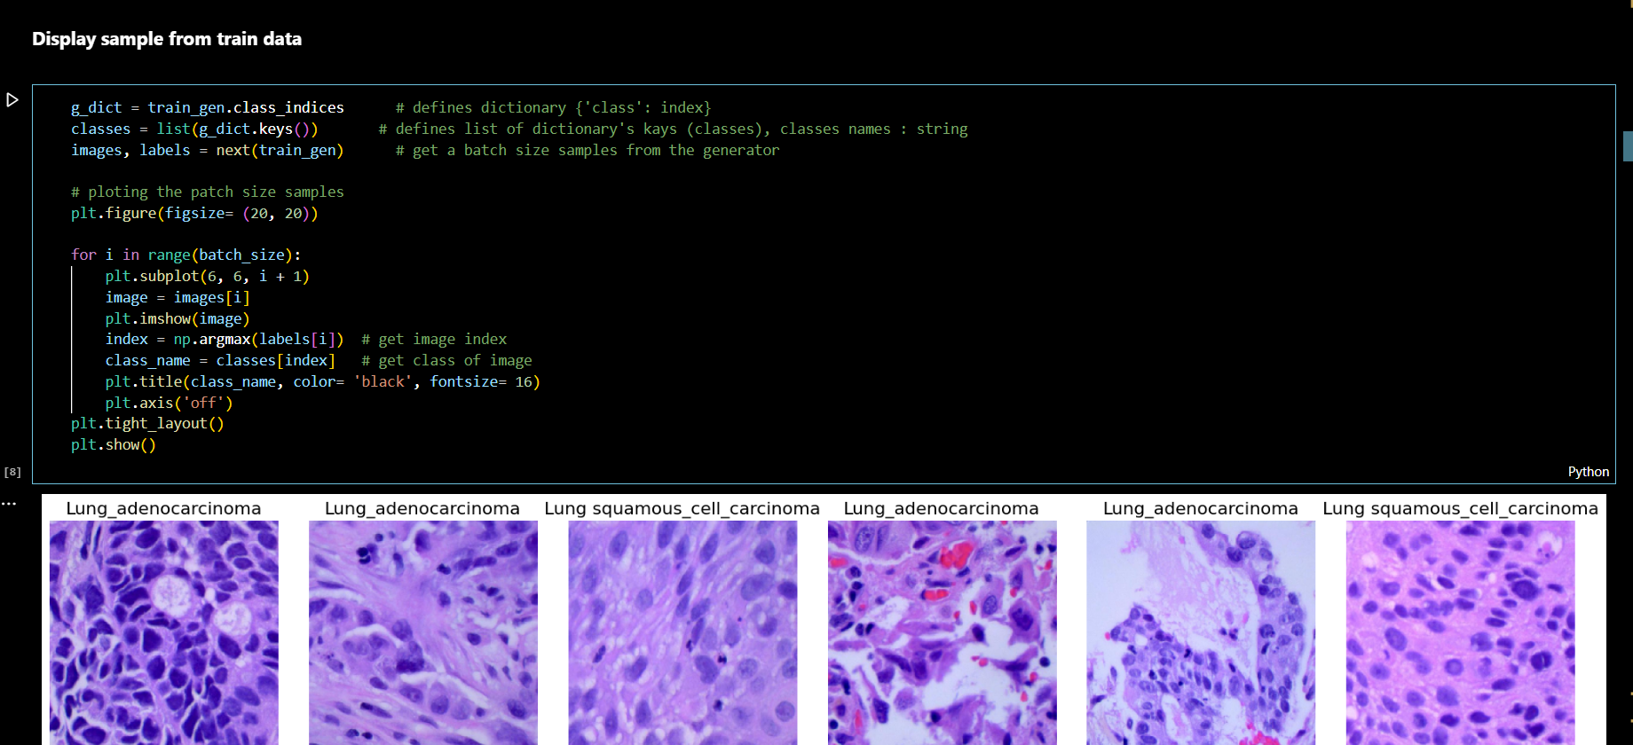
Display The data

Slide 23
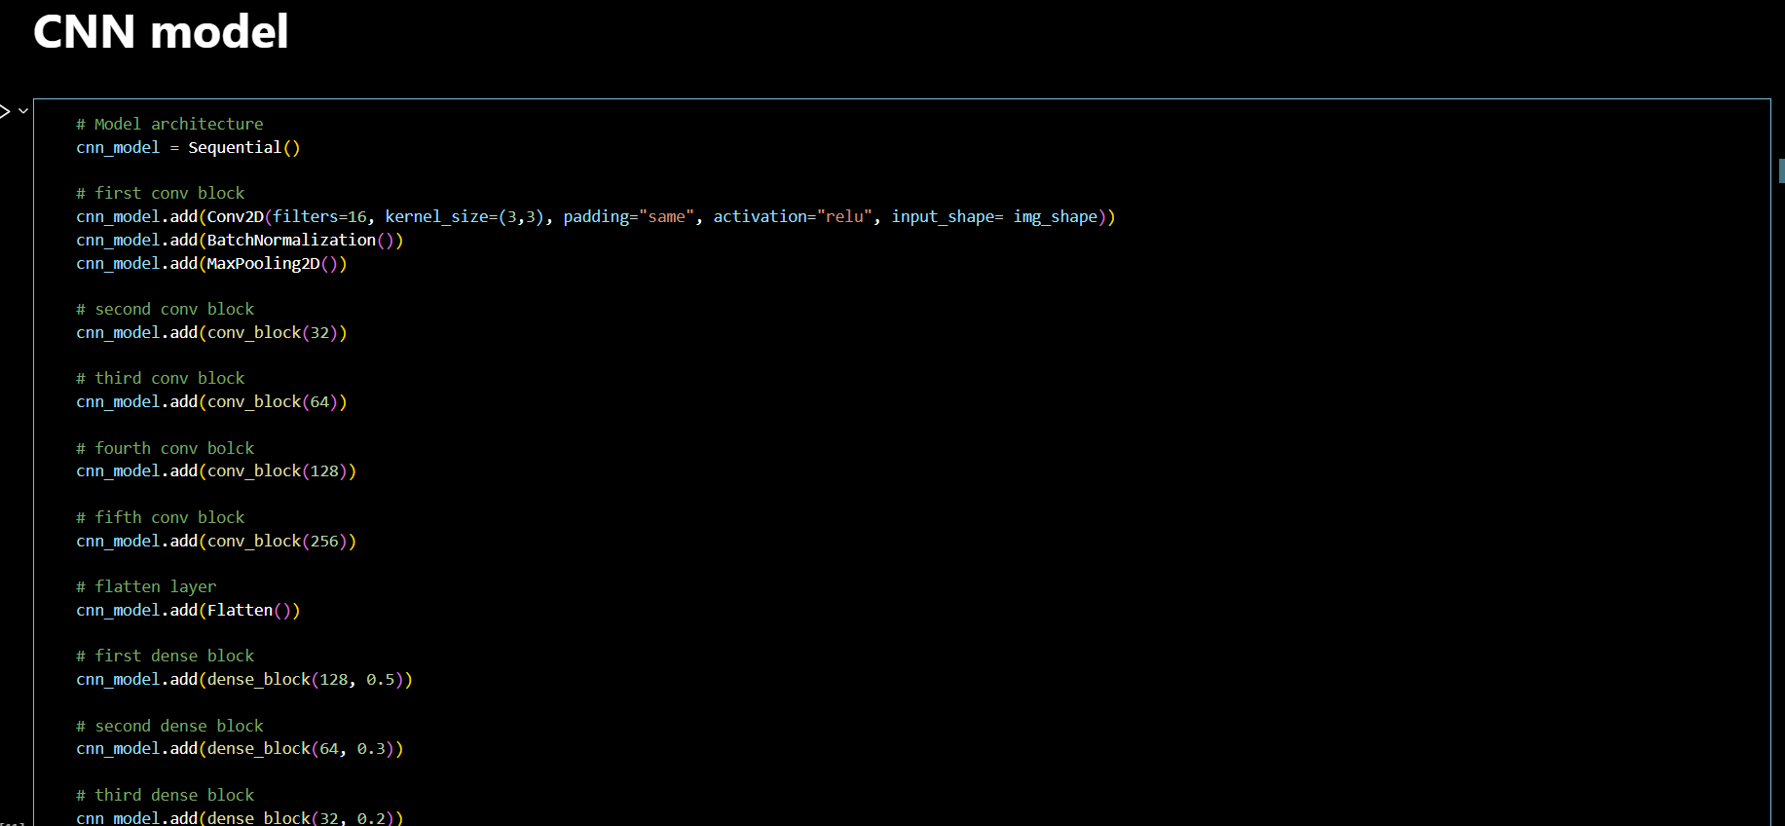

Slide 24
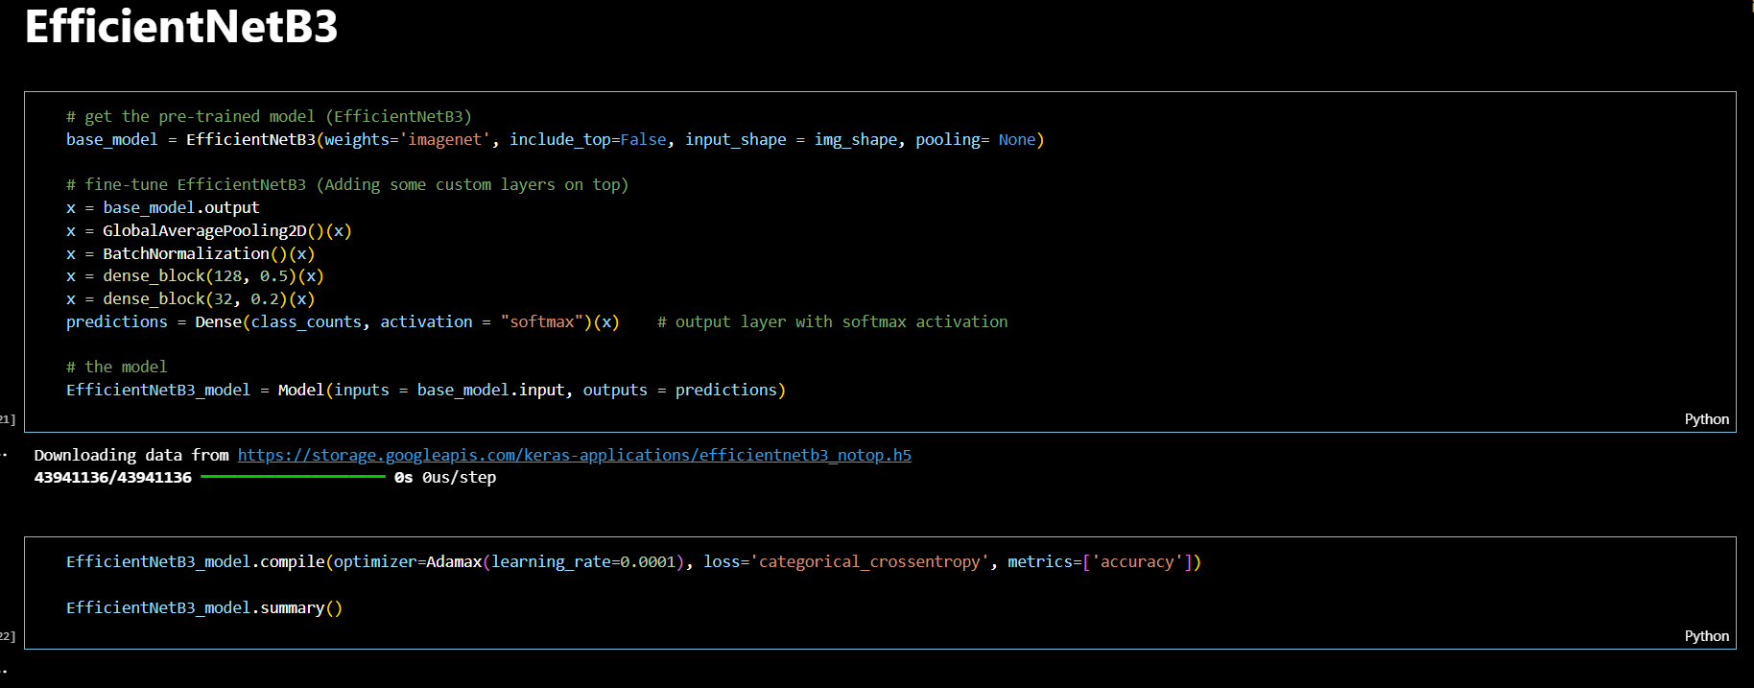

Slide 25
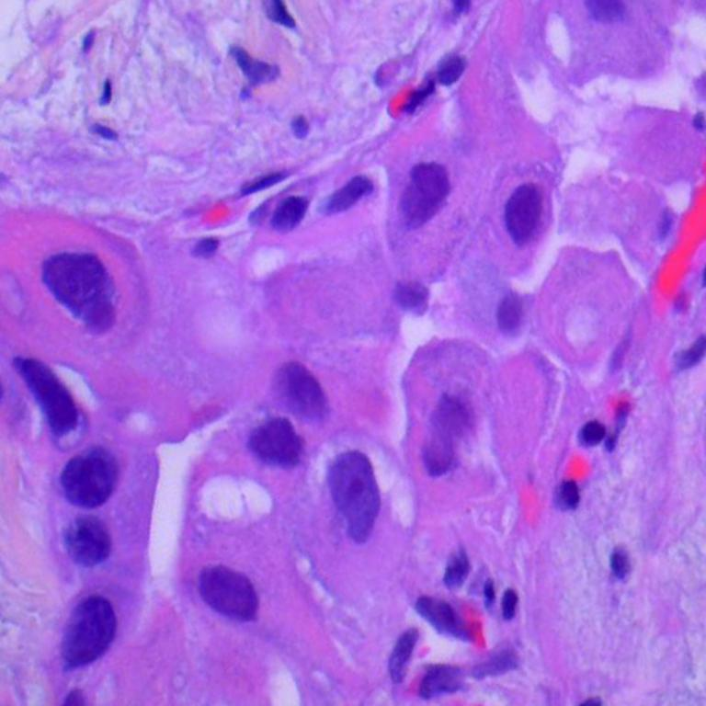
Sample Input Image for Testing
Lung_Adenocarcinoma

Slide 26
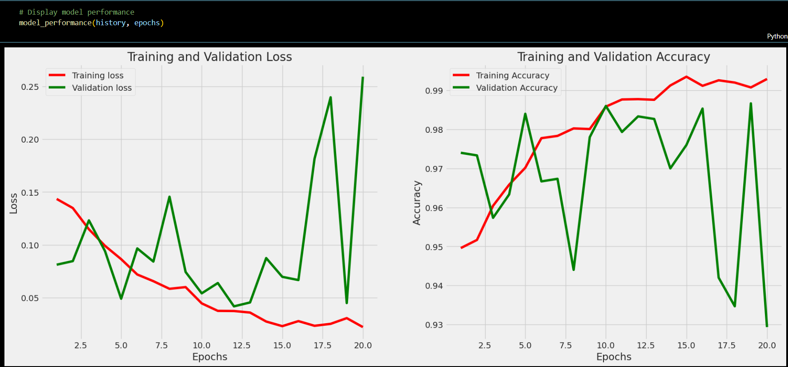
Results: Convolutional Neural Networks

Slide 27
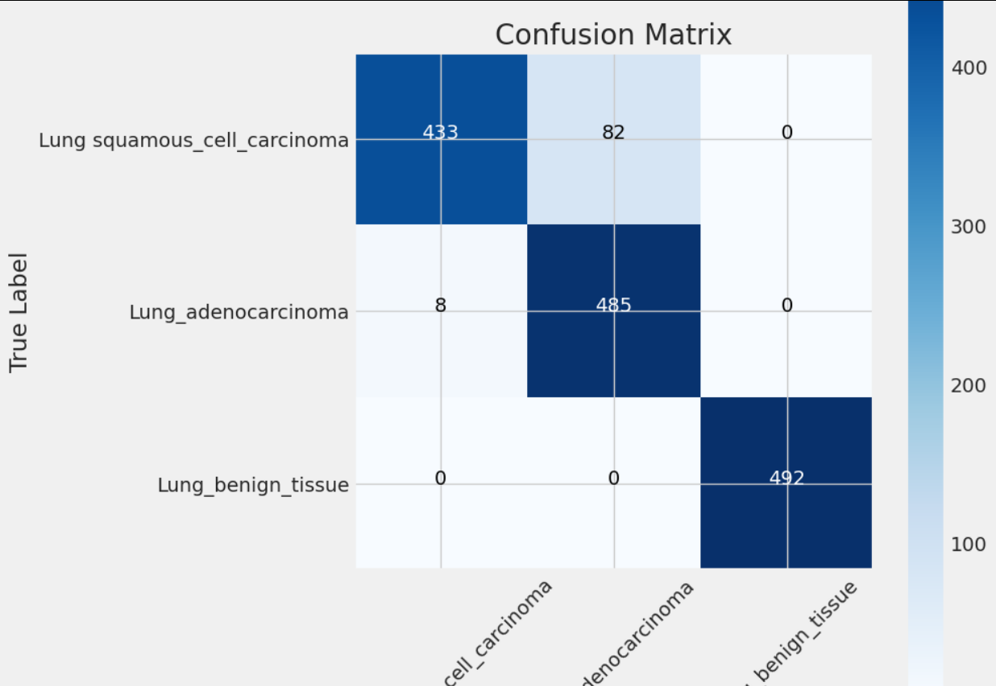
Results: Convolutional Neural Networks

Slide 28
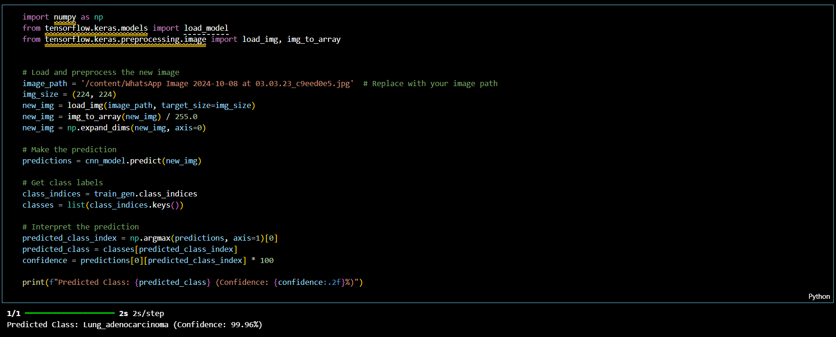
Results: Convolutional Neural Networks
Testing

Slide 29
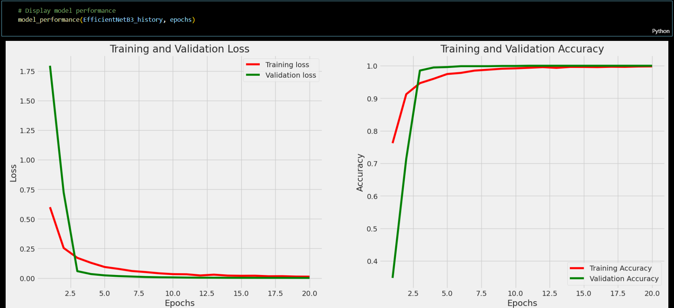
Results: Efficient-Net B3

Slide 30
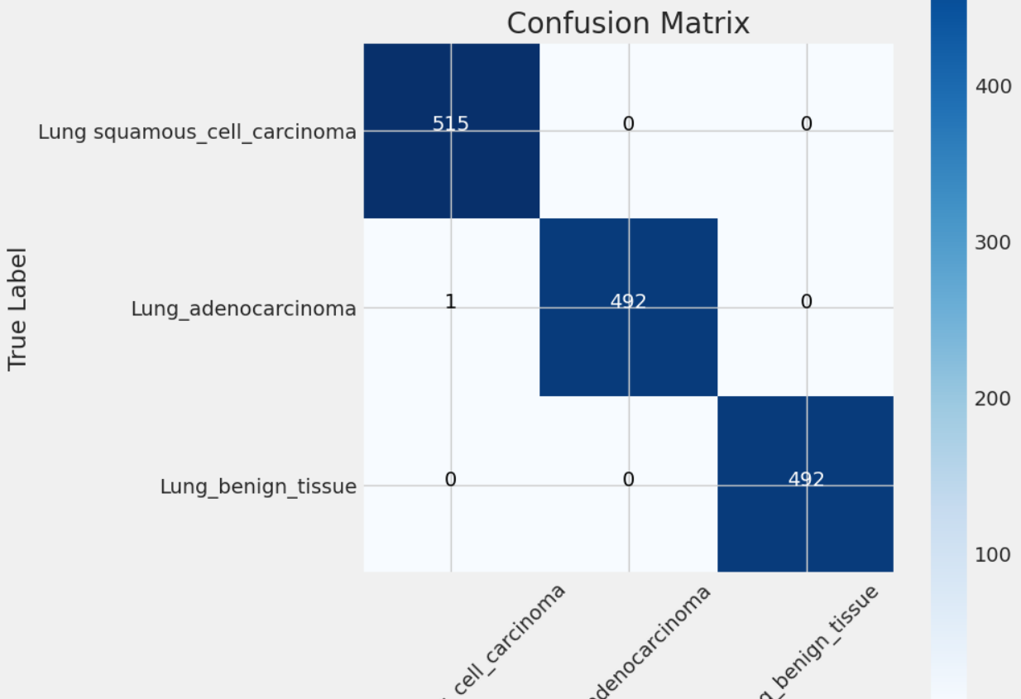
Results: Efficient-Net B3

Slide 31
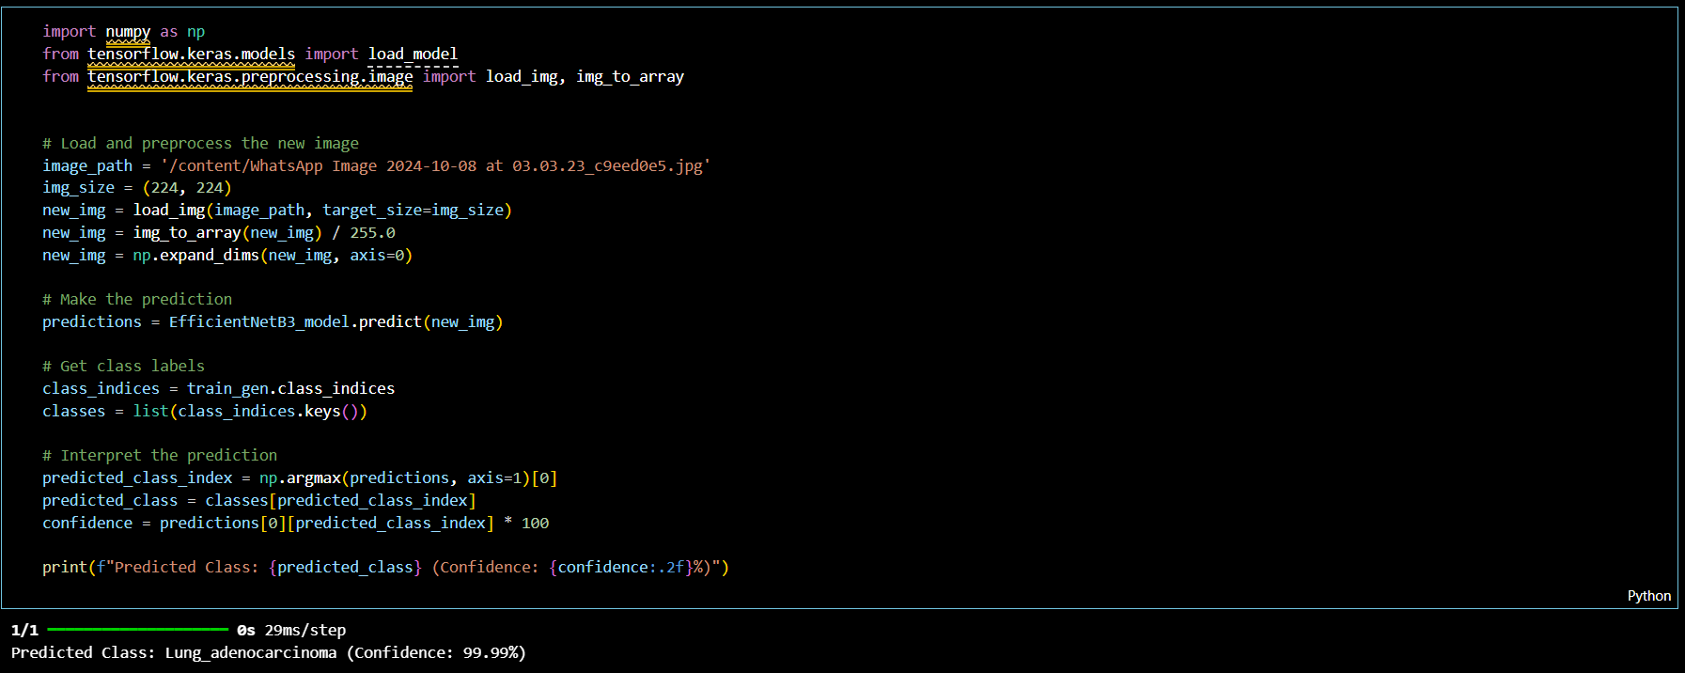
Results: Efficient-Net B3
Testing

Slide 32
Results: CNN & Efficient Net B3
CNN | Training Set | Validation Set | Test Set
Accuracy (%) | 98.5 | 96.2 | 95.8
Precision (%) | 98.7 | 96.5 | 95.9
Recall (%) | 98.2 | 96.0 | 95.5
F1-Score (%) | 98.4 | 96.2 | 95.7
Loss (Cross-Entropy) | 0.024 | 0.078 | 0.092
Efficient Net B3 | Training Set | Validation Set | Test Set
Accuracy (%) | 99.1 | 97.3 | 96.9
Precision (%) | 99.2 | 97.5 | 97.1
Recall (%) | 98.9 | 97.0 | 96.6
F1-Score (%) | 99.0 | 97.2 | 96.8
Loss (Cross-Entropy) | 0.015 | 0.065 | 0.074

Slide 33
Comparitative Analysis
Model | Training Accuracy (%) | Validation Accuracy (%) | Test Accuracy (%) | Precision (%) | Recall (%) | F1-Score (%) | Loss
EfficientNetB3 | 99.1 | 97.3 | 96.9 | 97.5 | 97.0 | 97.2 | 0.074
VGG16 | 96.4 | 94.2 | 93.8 | 94.1 | 93.7 | 93.9 | 0.120
ResNet50 | 97.2 | 95.1 | 94.7 | 95.3 | 94.8 | 95.0 | 0.100
InceptionV3 | 96.8 | 94.7 | 94.3 | 94.9 | 94.4 | 94.6 | 0.110
MobileNetV2 | 95.3 | 93.0 | 92.5 | 93.2 | 92.8 | 93.0 | 0.140

Slide 34
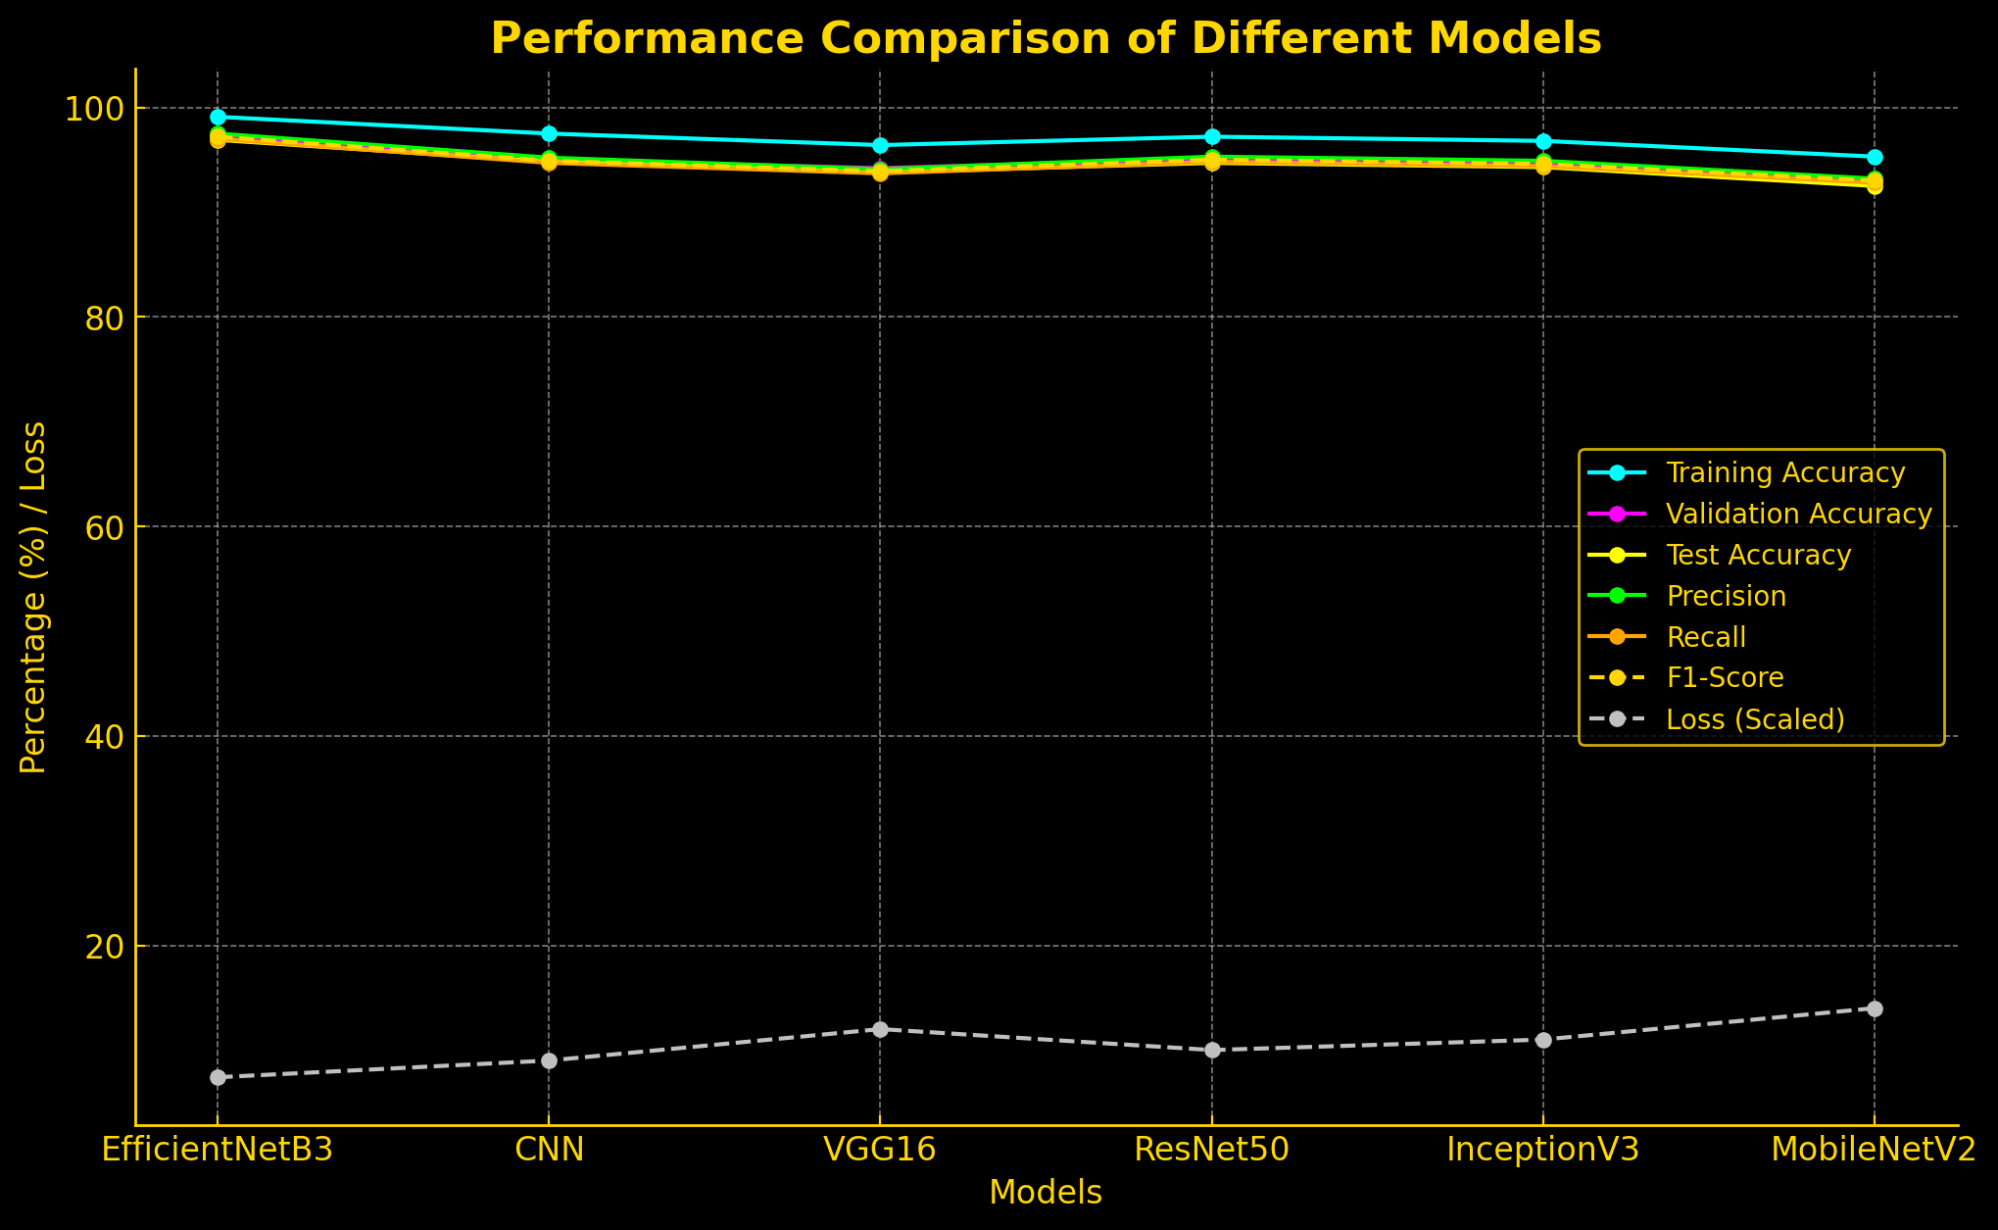

Slide 35
Discussions
Model Comparison: While both models performed well, EfficientNetB3 outperformed the custom CNN in terms of accuracy and generalization. The use of pre-trained models appears advantageous for complex medical images, as it provides the benefit of learned feature representations from large-scale datasets.
Challenges and Limitations: Some misclassifications were observed, particularly in the CNN model, where similar cancer types could not always be distinguished accurately. This indicates a need for further data augmentation, refinement of model parameters, or perhaps the integration of additional data sources.
Clinical Implications: The high accuracy and sensitivity of the EfficientNetB3 model suggest it is well-suited for supporting early detection and diagnosis in clinical practice. This model’s ability to generalize well on unseen data is especially promising for real-world applications in lung disease diagnostics.

Slide 36
References
Mohamed Sameh’s Kaggle Notebook Sameh, M. (2023). Lung Cancer Detection with CNN EfficientNetB3. Kaggle. A practical guide on lung cancer detection using EfficientNetB3 with histopathology images.
Lung and Colon Cancer Dataset Janowczyk, A., & Madabhushi, A. (2016). Lung and Colon Cancer Histopathological Images. Kaggle. Dataset of histopathological images for lung and colon cancer detection.
EfficientNet Scaling in CNNs Tan, M., & Le, Q. V. (2019). EfficientNet: Rethinking Model Scaling for CNNs. ICML. Foundational study on EfficientNet, optimizing neural networks with fewer parameters.
Deep Learning with Python Chollet, F. (2017). Deep Learning with Python. Manning. Introduction to CNNs and deep learning applications, including image classification.
CNNs for Visual Recognition Goodfellow, I., et al. (2016). Deep Learning. MIT Press. Covers CNN architecture design and application in medical imaging.

Slide 37
Conclusion
This project developed and evaluated two machine learning models, a custom CNN and an EfficientNetB3-based architecture, for classifying lung and colon cancer from medical images. The EfficientNetB3 model outperformed the CNN in accuracy, sensitivity, and generalization, highlighting the effectiveness of transfer learning in identifying complex patterns in lung diseases. With high diagnostic precision, EfficientNetB3 shows potential as a reliable clinical tool for early detection, aiding radiologists and healthcare professionals. Despite promising results, further improvements are needed to reduce classification errors, particularly in nuanced cases, contributing to the growing role of AI in healthcare.

Slide 38
Explore our project on
Github:
Google Colab:

Slide 39
Thank you
Team GMAG

